Slide 1
A Tailor for Giants:
VAR Models and Macroeconomic Indicators
Xinyu Bi, Davis DeRodes, Yang Wang, and Yingdan Zhang

Slide 2
Introduction
Macroeconomics is a branch of economics dealing with the structure, behavior, and decision-making of the economy.
Macroeconomists study the interrelations among aggregated indicators.
Fisher Effect
Phillips Curve
Federal Funds Rate
Unemployment Rate
Inflation
Consumer Price Index

Slide 3


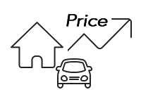
Introduction
Federal Funds Rate
Unemployment Rate
Inflation (CPI)
Depository Institutions
Raise FFR → borrow less money → cash hard to procure
Decrease FFR → encourage banks to borrow money → easy to make investment
FFR: a regulatory tool to control how freely the national economy operates.
A measure of the prevalence of unemployment
Unemployed / Labor Force
Job Seeking / (Employed+Job Seeking)
Recession → High unemployment rate
An increase in the price level of goods and services
Price rises → fewer goods per unit of currency
High inflation → reduce public's ability to make long-term decisions
Proper inflation → adjust interest rates → stabilize the economy → reduce unemployment rate
Fed aims for 2% inflation
Deflation?
Increase the real value of debt
Aggravate recession
Lead to a deflationary spiral (JPN)

Slide 4
Introduction - Unemployment Rate & Inflation
Laffer and Ranson (1971) concluded that unemployment rate and inflation do not have a relationship; the existence of a Phillips Curve cannot be confirmed.
McRae (1972) claims that there is a tradeoff between unemployment rate and inflation associated with monetary policy only in the short run.
Stock et al. (2001) built a VAR model using data from 1960 to 2000, and concluded that unemployment rate causes inflation.
High unemployment rate → need to boost economy → low interest rate

Slide 5
Introduction - Interest Rate & Inflation
According to the results of Fuei (2009), interest rate and inflation do have a positive relationship; however, there is not the one-to-one relationship as indicated by the Fisher Effect.
According to the results and discussion of Alveraz et al. (2001) and Mankiw (2001), there is a relationship between interest rate and inflation.
Raises interest rate → supply of money reduces → money scarcer → deflation

Slide 6
Introduction - Inflation & Interest Rate
The paper of Stock et al. (2001) also states that inflation forecasts through the Phillips Curve are more accurate than interest rates.
Ball (1999) paper concludes that countries that did not undergo expansionary monetary policy in the early 1980s resulted in interest rates that raised the natural rate of unemployment.
Proper positive inflation → adjust interest rates → stabilize the economy → reduce unemployment rate

Slide 7
The Goal of This Paper
Find the Interactions
Concurrent with the surrounding literature?
How to predict indicators?
Notes:
The current study applies the statistical analysis methods used in Stock et al. (2001), but it brings recent data to the forefront.

Slide 8
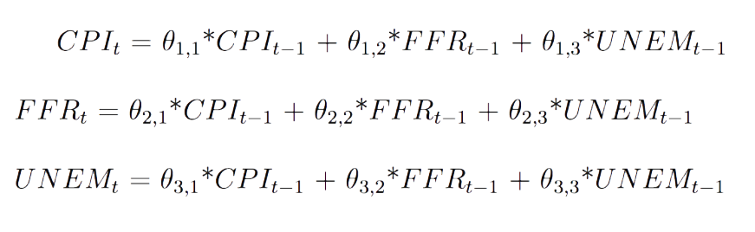
Unpacking the VAR(1) Model

Slide 9
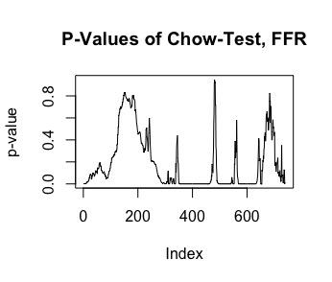
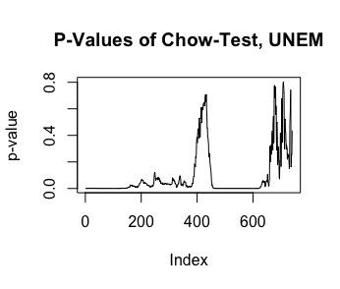
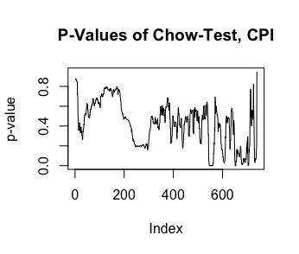
Breakpoint Analysis: Chow Test
F-Test on difference of parameters between two models at a point in time
Pros: Easy to explain, nice intuitiveness
Con: Not Deterministic
Problem: Because the data has such a large T, a lot of points are significant

Slide 10
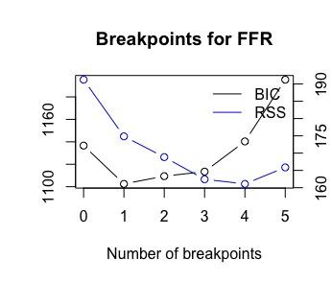
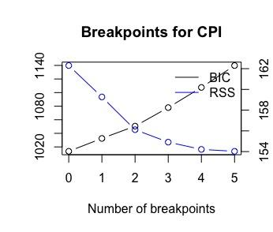
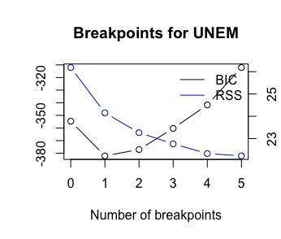
Simultaneous Estimation of Multiple Breakpoints
Algorithm developed by Bai and Perron
Uses Dynamic Programing to find breakpoints that minimize BIC (also want to minimize RSS)
Pro: Same intuitiveness of Chow Test and solves the problem of breakpoints “everywhere”
Pro: Deterministic
Con: Sometimes gives “bad” answers when there might be better ones
FFR: June, 1981
CPI: None!
UNEM: 634 (and 342)

Slide 11
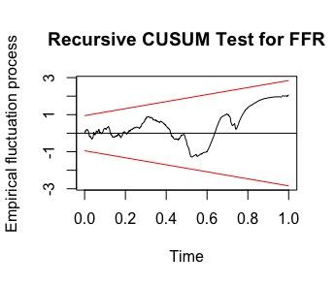
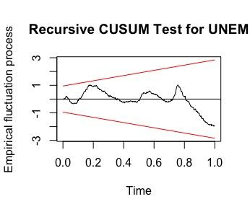
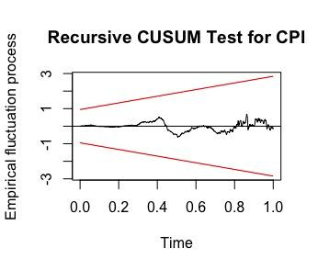
Recursive CUSUM Test
The recursive residual is the residual between the forecasted value from the model of T-1 observations and the true value of observation T.
The test is based of the “Cumulative Sum” of recursive residuals
If it passes the threshold then there is a structural break.
No Structural Breaks for any indicators past March, 1985

Slide 12

Alan Greenspan
Chair of Federal Reserve from 1987-2006

Slide 13
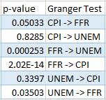
Granger Causality Test
For our forecast interpretation, we performed a Granger causality test. This tests for whether one indicator can be applicable to predicting another indicator. We created hypotheses for each possible combination through reading the conclusions of the research papers.
When we ran the Granger test on the indicators, we created this resulting table:

Slide 14
Granger Test Interpretation
Inflation predicts Federal Funds rate
Yes
Inflation has no relationship with Unemployment.
Yes

Slide 15
Granger Test Interpretation
Federal Funds Rate predicts Unemployment
Yes
Federal Funds rate predicts Inflation
Yes

Slide 16
Granger Test Interpretation
Unemployment helps to predict Inflation.
No
Unemployment predicts Interest Rate
Yes
Notes:
Our hypothesis was based on the Stock 2001 paper about unemployment and inflation that uses data from 1960 to 2000 and results in a p value of 0.02 for the Granger test. This is contradictory to our earlier statement that inflation has no effect on unemployment (McRae 1972) which was found to be true.

Slide 17
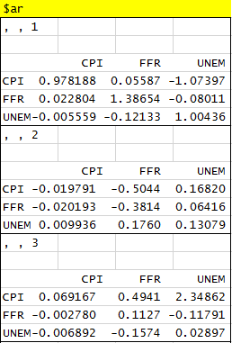
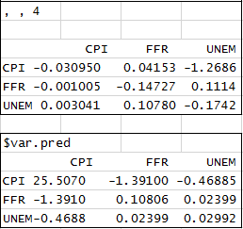
VAR(4) Model
Notes:
We performed a VAR model test and found one with the lowest BIC is the VAR(4) model meaning 4 lags (order of 4) is helpful in minimizing BIC.

Slide 18
In-Sample Forecast
Based on our VAR model, we plugged in historical values to do one-step forecast.
For each time t, we plugged in data values before t into the model to do the forecast.
We did so throughout the whole time period of the data set and compared our forecast result with the original data value.

Slide 19
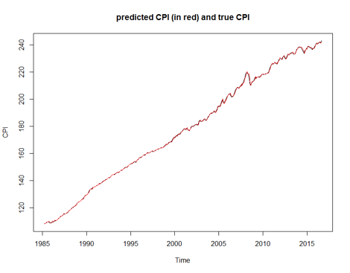
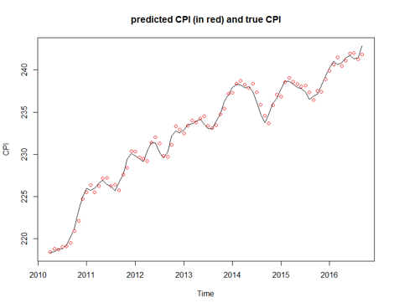
In-Sample Forecast

Slide 20
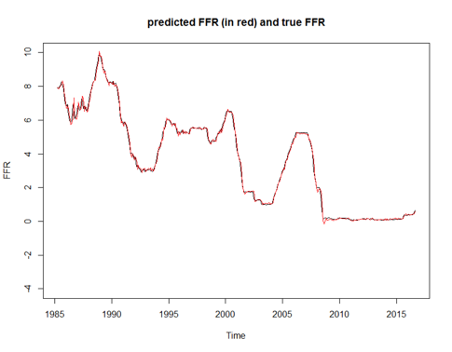
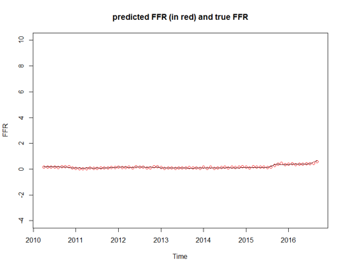
In-Sample Forecast

Slide 21
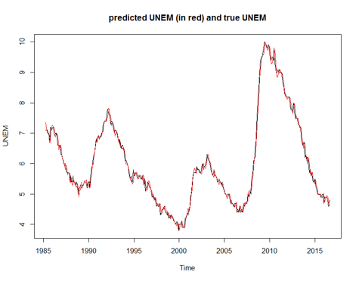
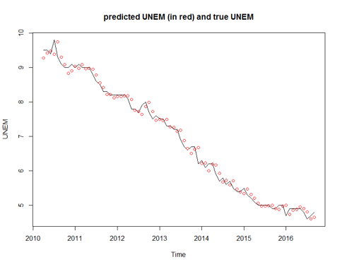
In Sample Forecast

Slide 22
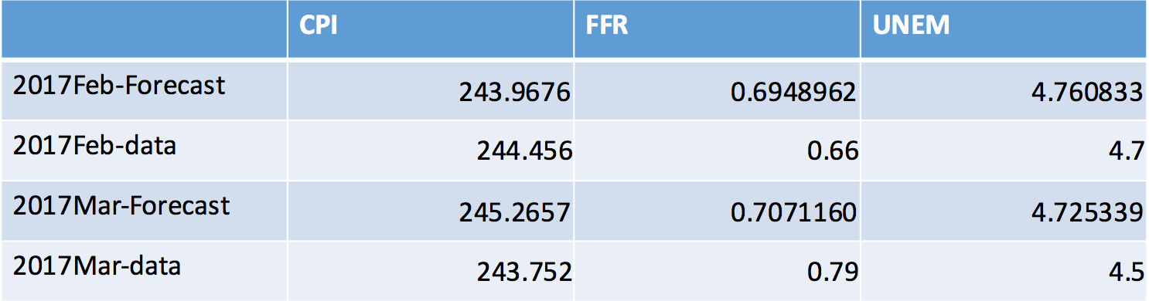
Out of Sample Forecast

Slide 23
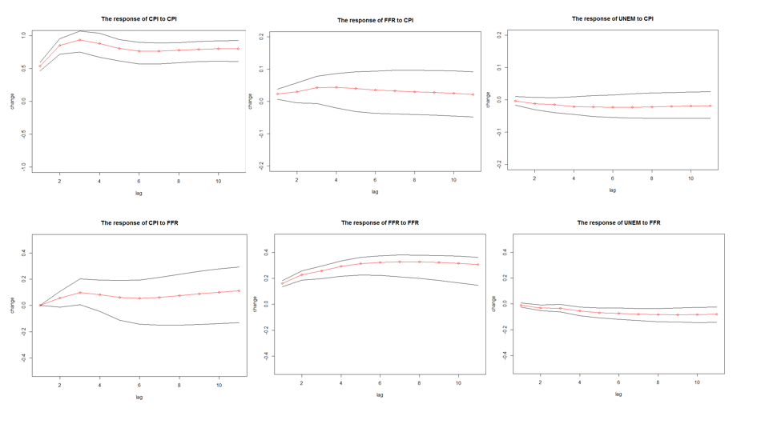
Impulse Response
Trace out the response of current and future values of the variables to a one-unit increase in the current value of one of the VAR errors
A thought experiment which helps us to see how the system will react to the change of variable
Better reveal how the whole economic system will react to a potential shock

Slide 24
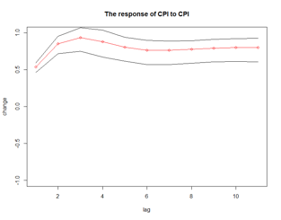
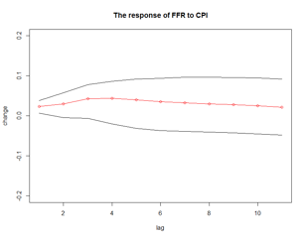
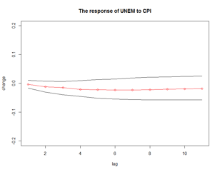
Impulse Response with Shock in Consumer Price Index

Slide 25
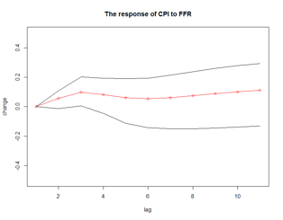
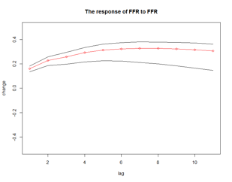
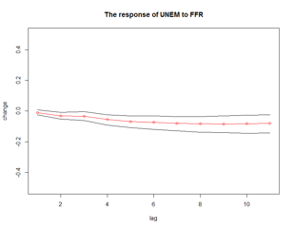
Impulse Response with Shock in Federal Funds Rate

Slide 26
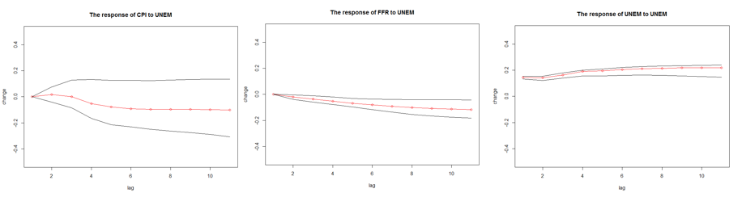
Impulse Response with Shock in Unemployment

Slide 27
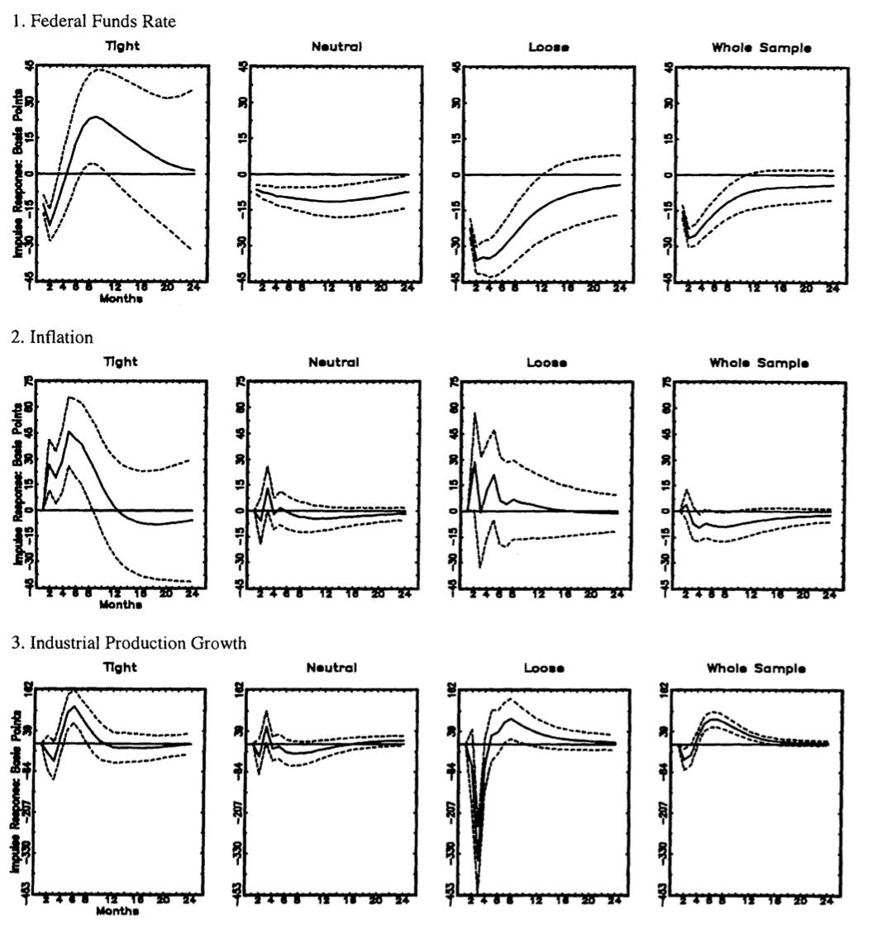
Next Steps
In the future, we would like to take into consideration Regime Policy Stances as outlined by Choi (1999).
Model shift in regimes using a threshold VAR (TVAR) model
Inflation rates vary greatly across regime types.

Slide 28
Next Steps
Integrate other macroeconomic indicators
Stock Market
Using Inflation Rate instead of CPI
Measured as
100 * 12 * ln(CPI_{t} / CPI_{t-1})
Cointegration of Federal Funds Rate and Inflation
Overfitting?

